Slide 1

MIPS FIVE STAGE PROCESSOR Verification Coverage Module using UVM
Team Members:
Attar Mujayiddin 9919005013
C Pavan Kumar 9919005034
D Hajipeera 9919005054 Faculty Guide:
K Sreenath Naidu 9919005122 Dr. K. Pandiaraj (Assistant Professor)

Slide 2
Scope and Objectives
Scope and Objectives
The MIPS processor design is one of the very first foundations of the modern day processor designs.
It brings various different fundamental concepts of modern day computing like pipelining, data dependency handling and forwarding into one place to enhance the capabilities and speed of processing.
This project proposes to verify the functionality of a five-stage pipelined mips processor. The design under test comes with a total of 16 instructions with a total of 49 variants, 5 pipeline stages and a hazard unit.
This project presents the verification of this design. The functionality of each instructions is tested using constrained random verification to implement these verification techniques in system Verilog unified verification methodology(uvm) is used.

Slide 3
Methodology
The MIPS processor this project intends to verify is a 16 bit, 5 staged pipelined processor. It provides 16 instructions with 49 variants. This verification process of this design involves first verifying individual blocks of each stage and then verifying the overall working of the design.
Although this remains a two-step process this is done by automating the verification process and making use of only one testing system which has interfaces to all the internal blocks as well as the main input-output blocks. By this process, the verification can be highly automated, high-speed and accurate.

Slide 4

Literature review
Sl.NO | Name of the Journal | Year | Keywords | Methodology
1. | A MIPS Processor Design, verification & Implementation (AZU-MIPS | 2016 | Processor, Million Instruction Per Second, (MIPS), Harvard architecture, Arithmetic Logic Unit (ALU) single-cycle processor | RTL coding of the design using Verilog HDL
2. | Pipeline MIPS-32 developed an architecture | 2017 | Register Transfer Level (RTL), Hardware Description Language (HDL), Filed Programmable Gate Array (FPGA) | RTL using Verilog HDL and implemented the on top of a DE0-CV Cyclone V Altera FPGA.
3. | Realization of 16-bit MIPS Processor | 2022 | Pipeline, embedded, fetch, combinational, sequential. | The architectural concept was built based on the Harvard data path is comprised of five pipeline stages: fetch, decode, execute, memory, and write back. The first step of it is analysing the data flow path inside the RISC processor which is comprised of two types of digital devices
4. | Implementation of a 32-bit MIPS based RISC processor using Cadence | 2014 | MIPS-32bit, cadence tool, RTL to GDS, Power dissipation | This paper presents perpetration of a 5- stage pipelined 32- bit High performance MIPS grounded RISC Core. MIPS(Microprocessor without Interlocked Pipeline Stages) is a RISC( Reduced Instruction Set Computer) armature. The main thing is to do the complete ASIC inflow (RTL to GDS II), using cadence tool
5. | FPGA Implementation of low power pipelined 32-bit RISC Processor | 2012 | FPGA, 32bit RISC, Low power, Clock gating | To reduce the power of RISC core, clock gating instruction is used in the architectural position as an effective low power system. Further improvement of channel armature can be done using Verilog and simulation is carried out using Model sim tool and enforced on FPGA board
2/10/2023
2

Slide 5
Literature review
Sl.NO | Name of the Journal | Year | Keywords | Methodology
6 | Low Power Pipelined MIPS Processor Design | 2009 | Low power, Xilinx strark-3E FPGA, MIPS | A modified armature is proposed that leads to significant power reduction by reducing unwanted transitions. Verilog design followed by conflation on to Xilinx stark- 3E FPGA was done. On- chip distributed memory of stark- 3E was used for the data and the program memory executions
7 | A single cycle mips risk processor design using VHDL | 2002 | Single cycle, MIPS, Timing Analysis | The RISC processor has fixed- length 32- bit instructions grounded on three different format R- format, I- format and J- format, and 32- bit general- purpose registers with memory word of 32- bit. The MIPS processor is separated into five stages instruction cost, instruction decode, prosecution, data memory and write back.
8 | Design of a 16-Bit Harvard Structure RISC Processor in Cadence 45nm Technology | 2019 | Physical Design, MIPS, RTL to GDS-II, Power, 45nm technology | The main end of the design is to design a 4- stage pipelined RISC processor starting from RTL to GDSII( Physical Design). The processor was enciphered by Verilog HDL language and enforced in Cadence Encounter Compiler tool. Calculated area, power, detention and timepiece gating using meter RTL compiler using slow and fast libraries of 45nm technology
2/10/2023
2

Slide 6
Workshop
Attended 2-days workshop at TCE college, Madurai on
“VLSI DESIGN - Universal Verification Methodology” and covered
The typical UVM Testbench Architecture.
The UVM Class Library Transaction Level Modelling(TLM).

Slide 7
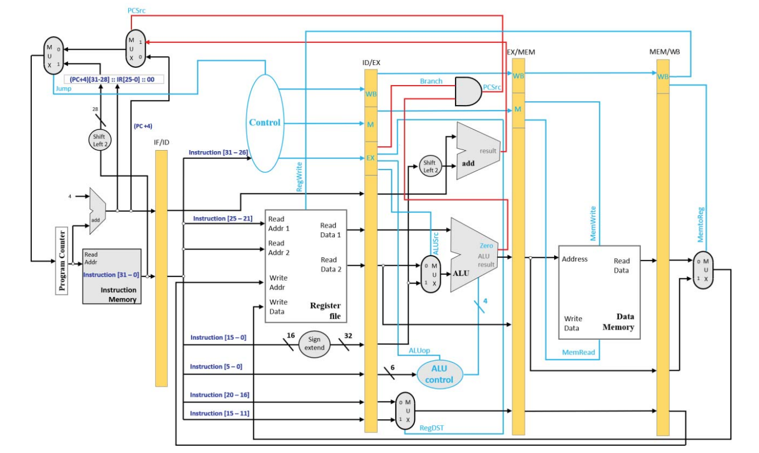
5-stage MIPS Pipeline

Slide 8
UVM ARCHITECTURE
MIPS PROCESSOR

Slide 9
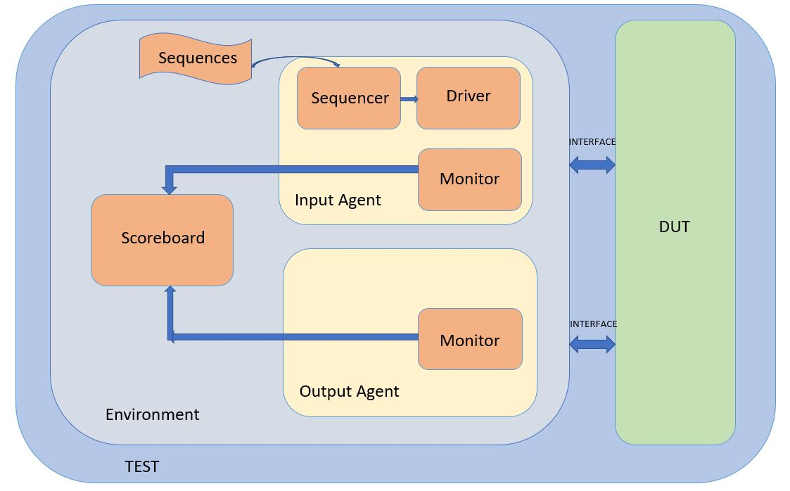
UVM ARCHITECTURE

Slide 10
UVM ARCHITECTURE
An agent is a container that holds all the needed components for a particular protocol. A typical UVM agent might contain a driver, monitor, and sequencer.
The sequencer controls the flow of sequences that are created either with constrained random or directed data. You can think of a sequence as a packet of data that represents a transaction or protocol. Essentially, a sequencer passes a transaction to the driver.
The driver then drives the interface based on the bus protocol with that transaction. The driver can also send a response to the sequencer, if necessary.
The monitor captures the transactions based on the protocol and can implement checkers to verify the protocol

Slide 11
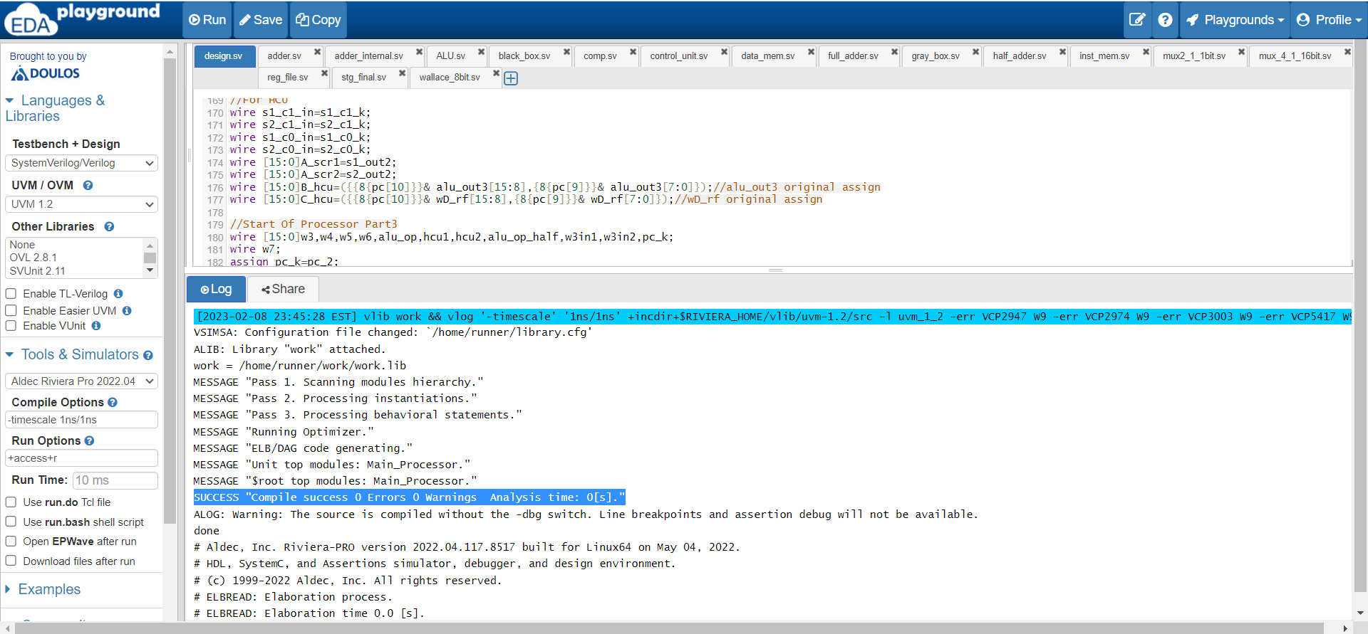
Design Implementation

Slide 12
FUNCTIONAL COVERAGE
MIPS PROCESSOR

Slide 13
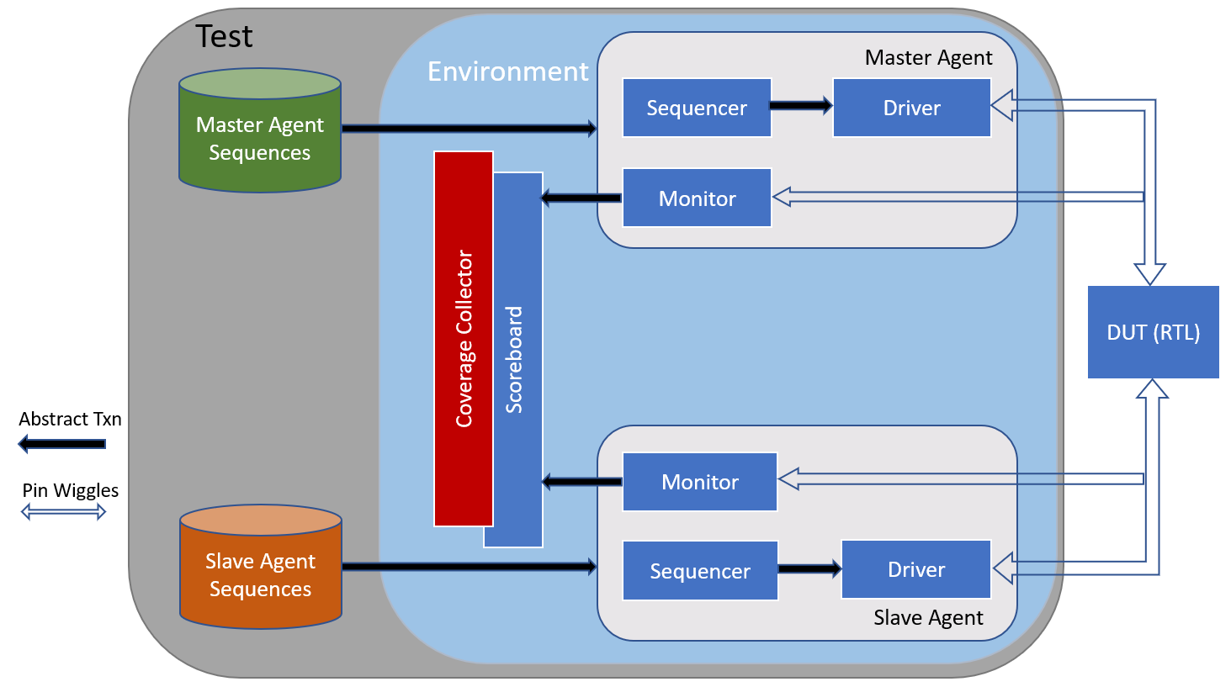
FUNCTIONAL COVERAGE

Slide 14
FUNCTIONAL COVERGE
Functional coverage in UVM is a user-defined metric that measures how much of the design specification that are captured in the test plan has been exercised.
Used to measure whether interesting scenarios, corner cases, specification invariant have been observed, validated, and tested.
It is used to access that the random and focused tests adequately exercise the design.
System Verilog has a rich set of coverage construct to enable functional coverage collection
Focus of functional coverage in UVM is on the inputs to the DUT. To check if all the valid combinations of inputs/stimulus were exercised.

Slide 15
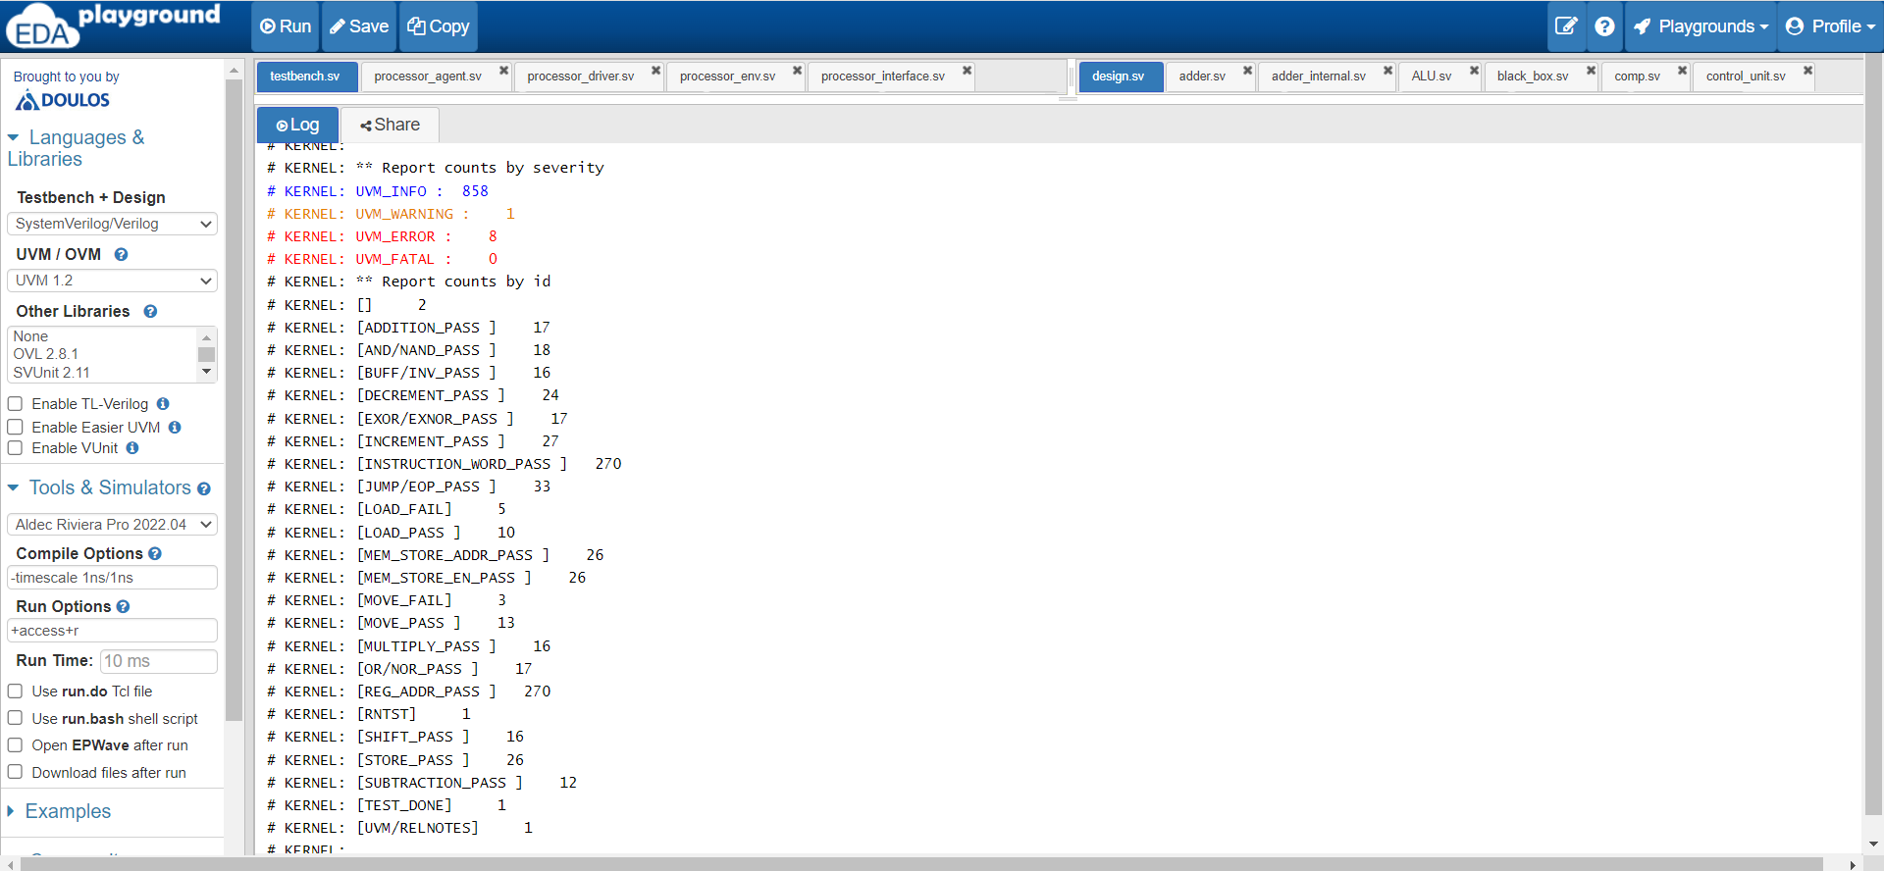
Final Output

Slide 16
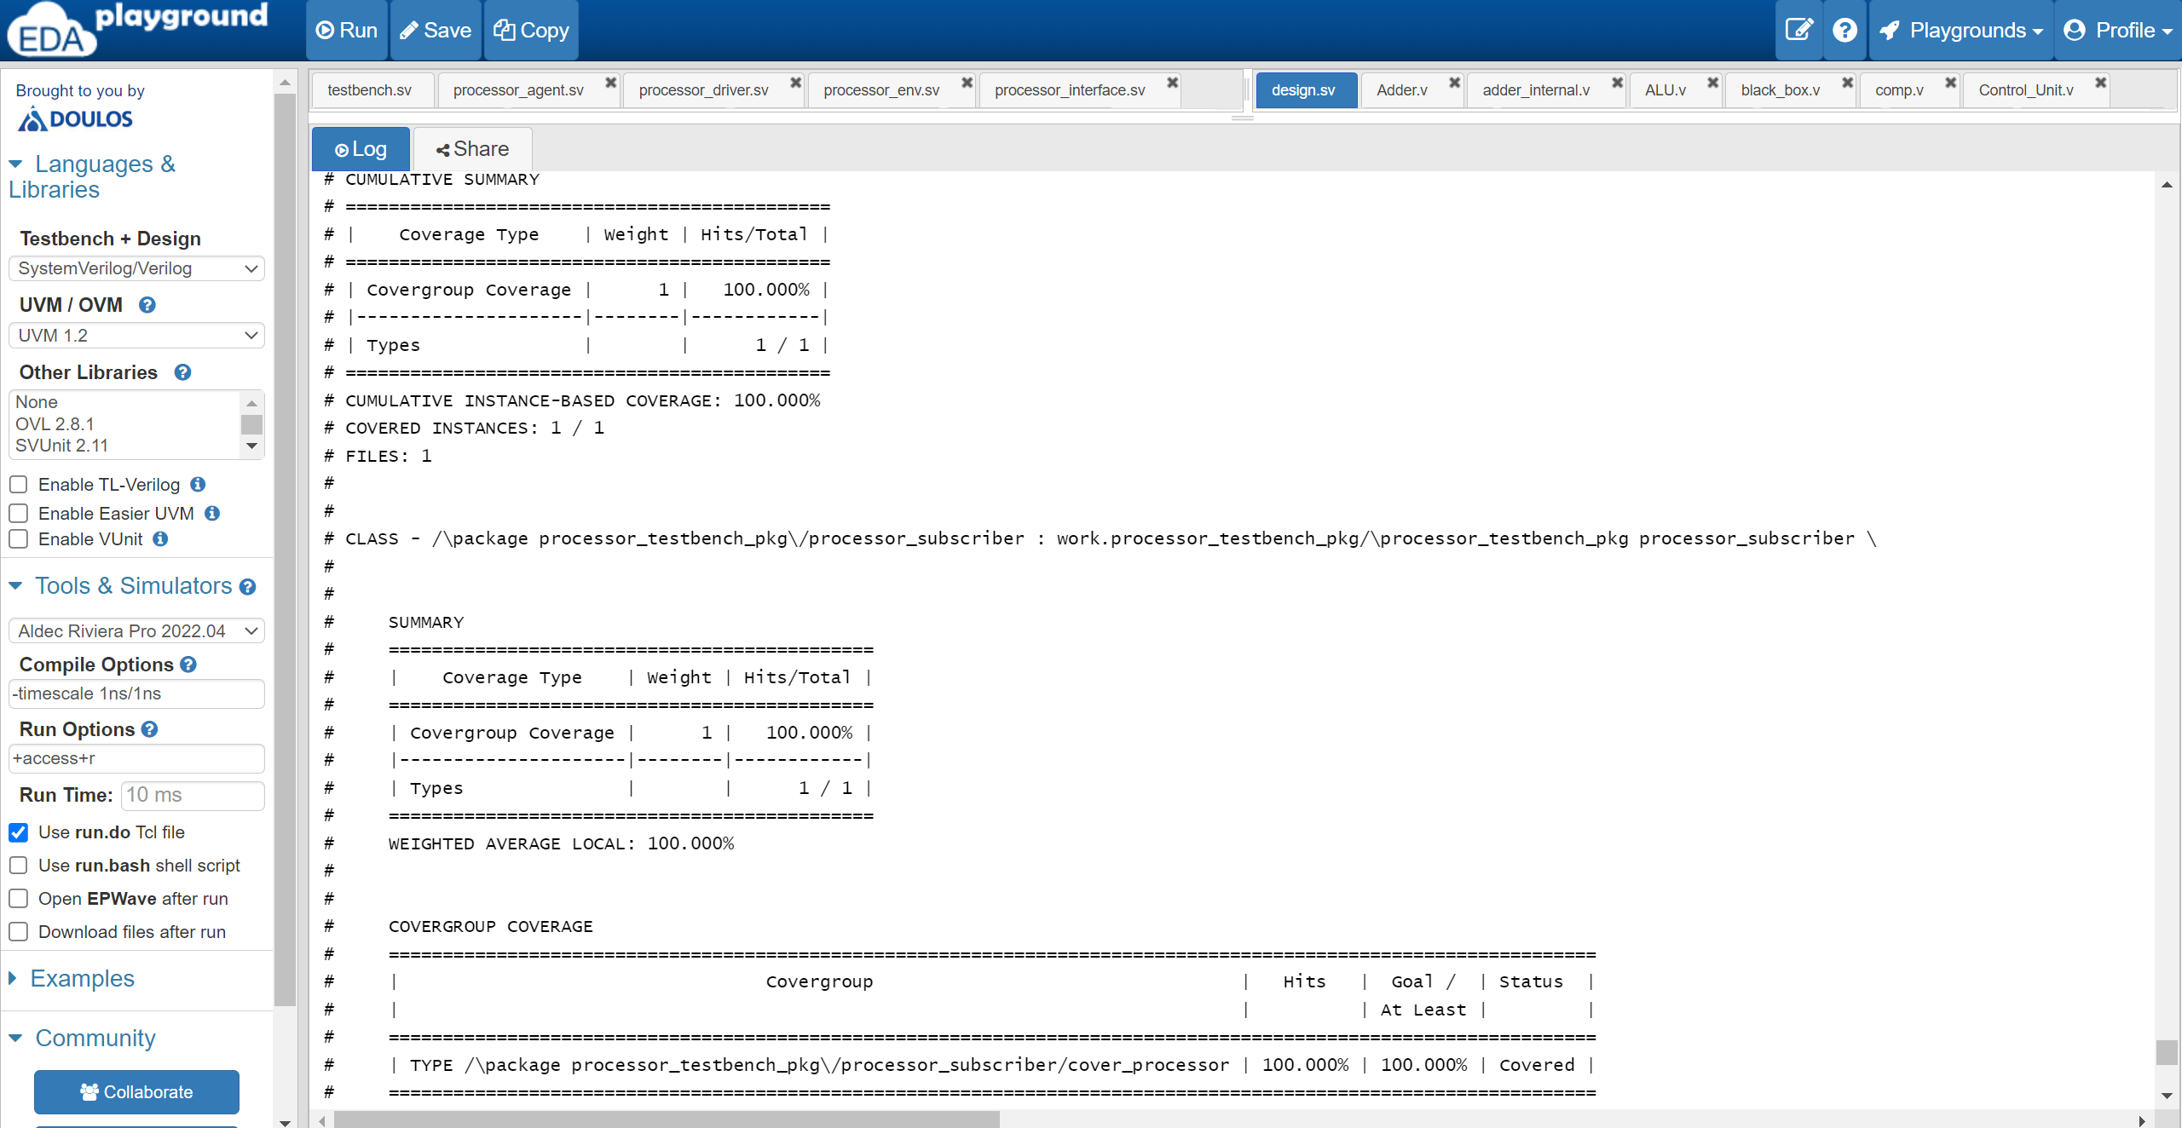
Final Output

Slide 17
Work Plan
Description of Work | Duration in weeks
 | ODD Semester |  |  |  |  |  |  |  |  |  |  |  |  |  |  |  | EVEN Semester
 | August |  |  |  | September |  |  |  | October |  |  |  | November |  |  |  | January |  |  |  | February |  |  |  | March |  |  |  | April | May
Literature Survey on driver verification of processor based on Universal Verification Methodology (UVM)
Identifying the base paper and Analysis
Interpretation of pipelined concept (5 stages)
Analysis of environment architecture of UVM
Understanding and analysis of the driver module in the UVM architecture
Interpretation and analysis of sequencer driver communication
Preparation of Abstract and Problem Statement for report
Feature extraction from DUT, Interfacing hierarchy
Preparation of verification plan: Design construction, coverage groups, writing test cases
Building verification components, Run test cases
Final implementation
Inference and hypothesis of Unified Verification Methodology framework

Slide 18
Thank You

